Slide 1
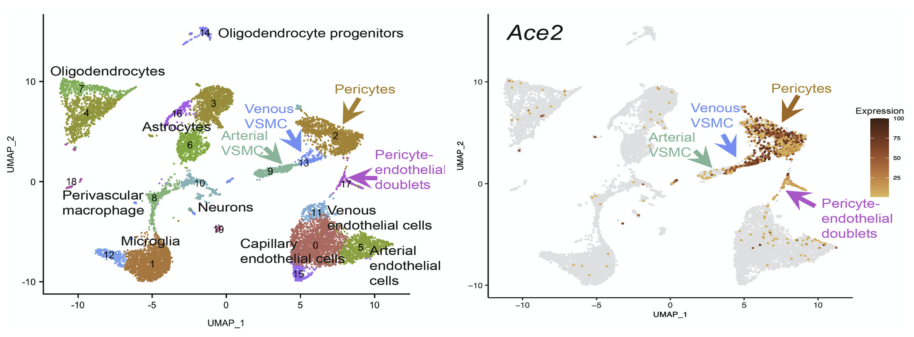
EVBO Publication highlight – April 2022
The SARS-CoV-2 receptor ACE2 is expressed in mouse pericytes but not endothelial cells: Implications for COVID-19 vascular research. Muhl L, He L, Sun Y, Mäe M, Pietilä R, Liu J, Genové G, Zhang L, Xie Y, Leptidis S, Mocci G, StrittS, Osman A, Anisimov A, Hemanthakumar KA, Räsänen M, Hansson EM, Björkegren J, Vanlandewijck M, Blomgren K, Mäkinen T, Peng X, Hu Y, Ernfors P, Arnold TD, Alitalo K, Lendahl U, Betsholtz C.Stem Cell Reports 2022 Apr 21. DOI: https://doi.org/10.1016/j.stemcr.2022.03.016.
Summary: Muhl and colleagues report on humanized mouse models and mouse-adapted SARS-CoV-2 virus, which are increasingly used to study COVID-19 related pathogeneses.
For these studies, it appears important to learn where the SARS-CoV-2 receptor ACE2 is expressed within the vascular system. The investigators from Uppsala mapped ACE2 expression during mouse postnatal development and in adulthood. They discovered that pericytes in the CNS, heart, and pancreas express ACE2 strongly, as do perineurial and adrenal fibroblasts, whereas endothelial cells do not at any location analyzed by the investigators.
In a number of other organs, pericytes seem not to express ACE2, including in the lung where ACE2 instead is expressed in the bronchial epithelium and alveolar type II cells. The onset of ACE2 expression is further reported to be organ specific: in bronchial epithelium already at birth, in brain pericytes before, and in heart pericytes after postnatal day 10.5.
Establishing the vascular localization of ACE2 expression is considered central by the investigators to correctly interpret data from modeling COVID-19 in murine models, and may shed light on the cause of vascular COVID-19 complications.

